Slide 1
Postman api tests collection in jenkins

Slide 2
Agenda
1. MOTIVATION
2. TEST SUITE
3. RUN DEMO
4. HOW TO RUN POSTMAN API TEST COLLECTION IN JENKINS.
5. REFERENCES

Slide 3
1. MOTIVATION
Reduce effort for project
Minimize risk once bugs are detected
Reduce manual process that consists of repetitive steps
Enhance project's quality
Develop project quickly

Slide 4
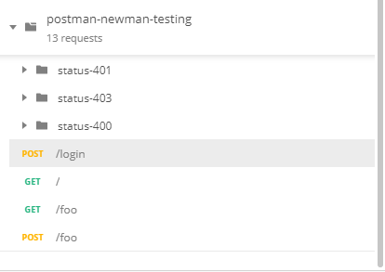
2. Test suite
2.1 There are four test suites
- Test Suite 1: Login
- Test Suite 2: Status 401-Unauthorized
- Test Suite 3: Status 403-Forbidden
- Test Suite 4: Status 400- username or password is incorrect

Slide 5
3. Run demo
3.1 Show test case result on Jenkins
- Create API, write test case
- Configure variable environment
- Postman run collection
3.2 Automation CI/CD based on Jenkins
- Integrated with jenkins to check test case automatically after every process of commiting code

Slide 6

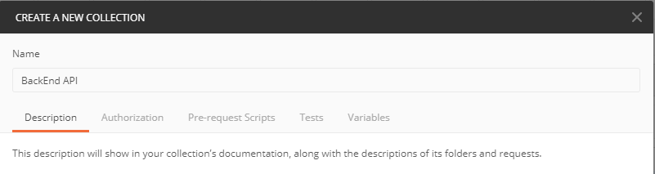
4. HOW TO RUN POSTMAN API TEST COLLECTIon IN JENKINS.
4.1 Create collection and api on postman
-Step 1: In postman choose New Collection
-Step 2: Create Collection Name and choose Create button

Slide 7
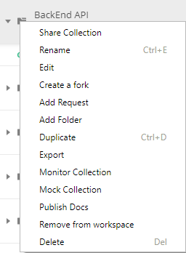
4. HOW TO RUN POSTMAN API TEST COLLECTIon IN JENKINS.
4.1 Create collection and api on postman
-Step 3: Right click folder ‘BackEnd API’ and choose ‘Add Request’

Slide 8
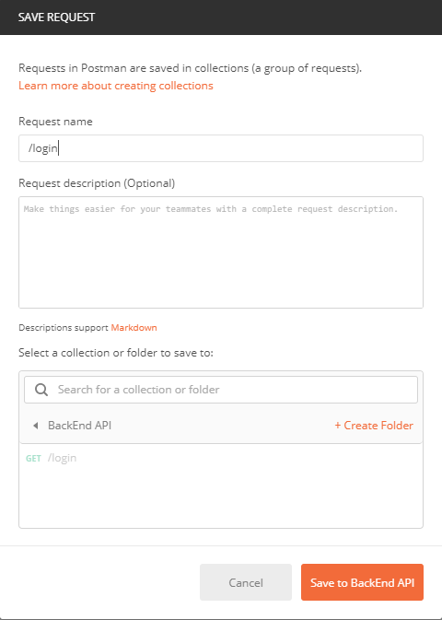
4. HOW TO RUN POSTMAN API TEST COLLECTIon IN JENKINS.
4.1 Create collection and api on postman
-Step 4: Create request name and save

Slide 9
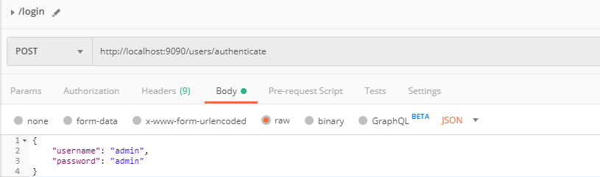
4. HOW TO RUN POSTMAN API TEST COLLECTIon IN JENKINS.
4.1 Create collection and api on postman
-Step 5: Create url API and body

Slide 10


4. HOW TO RUN POSTMAN API TEST COLLECTIon IN JENKINS.
4.2 Use environment variable and data
- Step 1: Click icon setting in post man
- Step 2: Click Add button

Slide 11
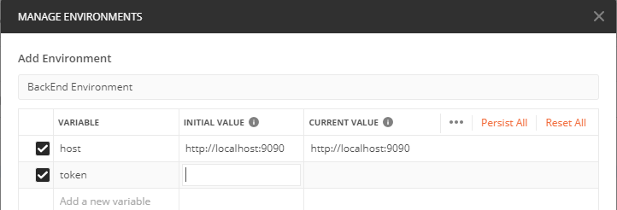
4. HOW TO RUN POSTMAN API TEST COLLECTIon IN JENKINS.
4.2 Use environment variable and data
Step 3: Create environment name, and variable

Slide 12
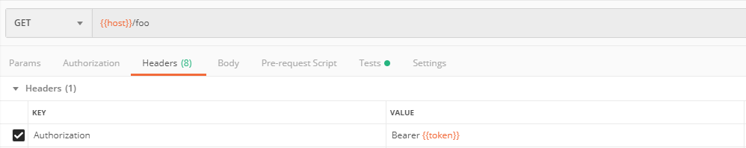
4. HOW TO RUN POSTMAN API TEST COLLECTIon IN JENKINS.
4.2 Use environment variable and data
Step 4: Update url API
Step 5: Use data in environment

Slide 13
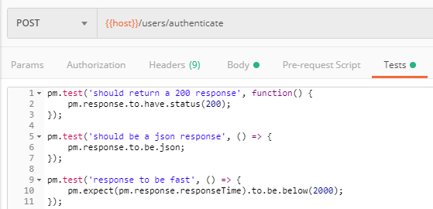
4. HOW TO RUN POSTMAN API TEST COLLECTIon IN JENKINS.
4.3 Test and update environment
Step 4: Write test script in tests tab

Slide 14
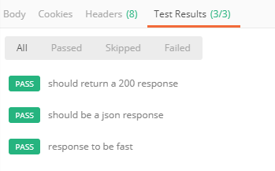
4. HOW TO RUN POSTMAN API TEST COLLECTIon IN JENKINS.
4.3 Test and update environment
Step 5: Test results will show like image:

Slide 15
4. HOW TO RUN POSTMAN API TEST COLLECTIon IN JENKINS.
4.3 Test and update environment
Step 6: Update environment in tests tab

Slide 16
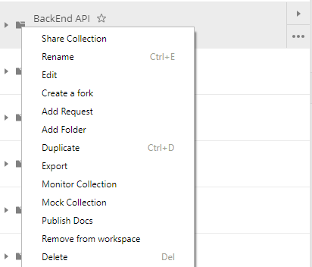
4. HOW TO RUN POSTMAN API TEST COLLECTIon IN JENKINS.
4.4 Export/Import collection to Newman
4.4.1 Export collection to Newman
Step 1: Right click folder BackEnd API and select ‘Export’

Slide 17
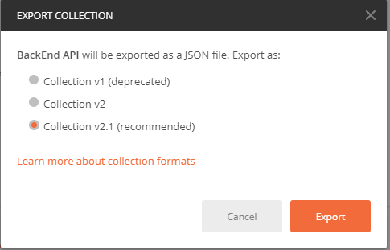
4. HOW TO RUN POSTMAN API TEST COLLECTIon IN JENKINS.
4.4 Export/Import collection to Newman
4.4.1 Export collection to Newman
Step 2: Click the recommended version to export

Slide 18
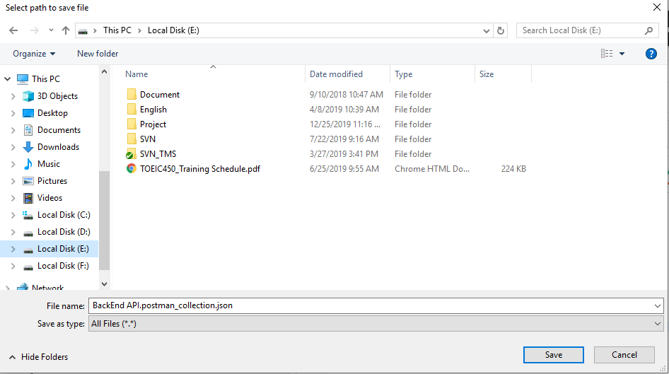
4. HOW TO RUN POSTMAN API TEST COLLECTIon IN JENKINS.
4.4 Export/Import collection to Newman
4.4.1 Export collection to Newman
Step 3: Choose the location for the exported file

Slide 19

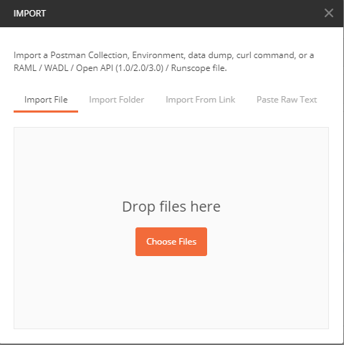
4. HOW TO RUN POSTMAN API TEST COLLECTIon IN JENKINS.
4.4 Export/Import collection to Newman
4.4.2 Import collection to Newman
Step 1: Click import button in postman interface
Step 2: Choose files to upload

Slide 20
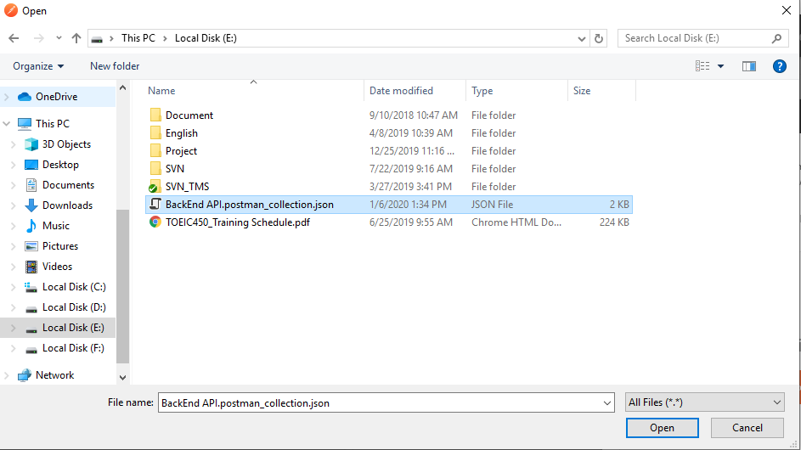
4. HOW TO RUN POSTMAN API TEST COLLECTIon IN JENKINS.
4.4 Export/Import collection to Newman
4.4.2 Import collection to Newman
Step 3: Choose the correct item to import and press open

Slide 21
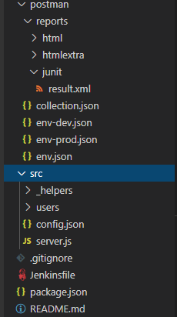
4. HOW TO RUN POSTMAN API TEST COLLECTIon IN JENKINS.
4.5 Intergrate with Jenkins
Step 1: Architecture in backend

Slide 22
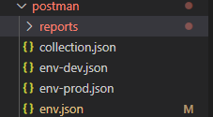
4. HOW TO RUN POSTMAN API TEST COLLECTIon IN JENKINS.
4.5 Intergrate with Jenkins
Step 2: Export and save collection and env file to /postman folder

Slide 23
4. HOW TO RUN POSTMAN API TEST COLLECTIon IN JENKINS.
4.5 Intergrate with Jenkins
Step 3: Setup newman and Jenkins
- Newman: npm install --save-dev newman
- Jenkins: https://www.blazemeter.com/blog/how-to-install-jenkins-on-windows/

Slide 24
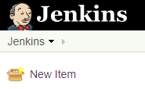
4. HOW TO RUN POSTMAN API TEST COLLECTIon IN JENKINS.
4.5 Intergrate with Jenkins
Step 4: In Jenkins interface, choose ‘New Item’

Slide 25
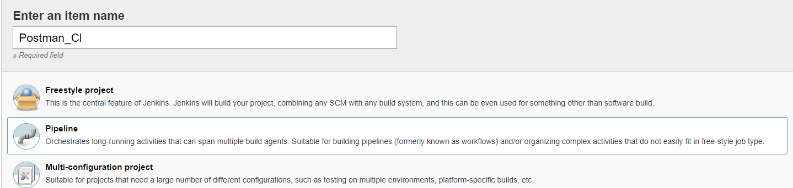
4. HOW TO RUN POSTMAN API TEST COLLECTIon IN JENKINS.
4.5 Intergrate with Jenkins
Step 5: Create item name and select Pipeline

Slide 26
4. HOW TO RUN POSTMAN API TEST COLLECTIon IN JENKINS.
4.5 Intergrate with Jenkins
Step 6: Select My Views and choose Postman_CI

Slide 27
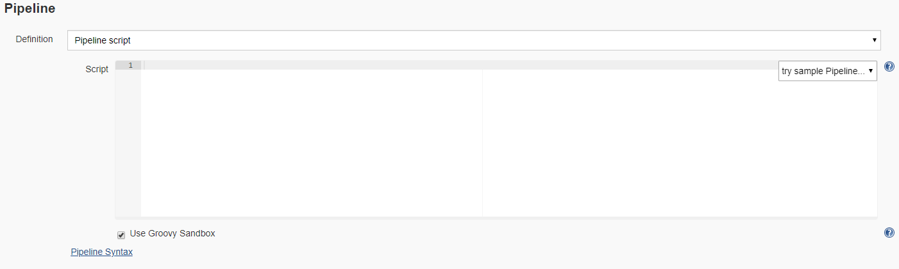
4. HOW TO RUN POSTMAN API TEST COLLECTIon IN JENKINS.
4.5 Intergrate with Jenkins
Step 7: Select configure and scroll down to the Pipeline section

Slide 28
4. HOW TO RUN POSTMAN API TEST COLLECTIon IN JENKINS.
4.5 Intergrate with Jenkins
Step 8:
Choose option ‘Pipeline script from SCM’ in Definition select box
Choose option ‘Git’ in SCM select box

Slide 29
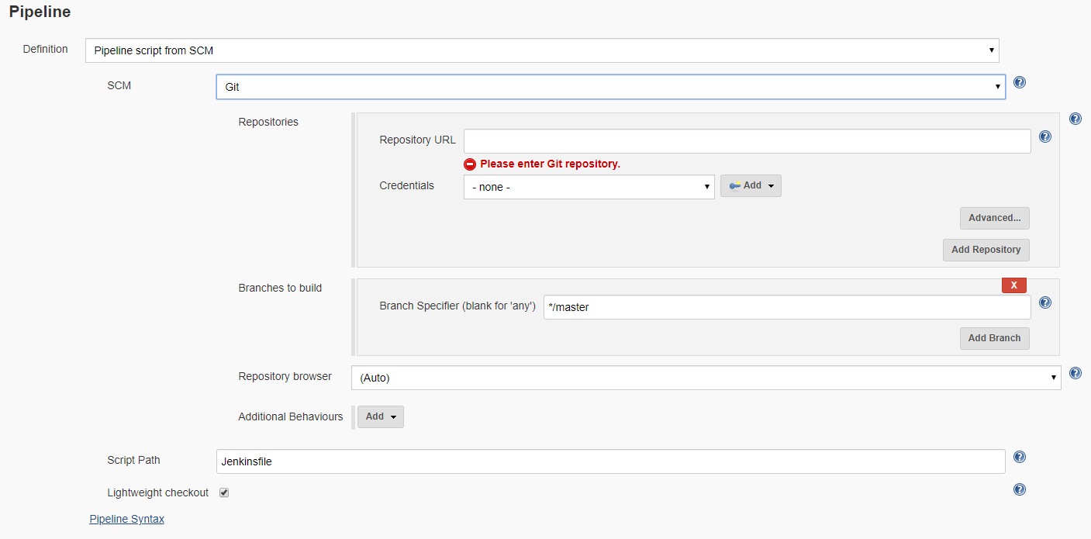
4. HOW TO RUN POSTMAN API TEST COLLECTIon IN JENKINS.
4.5 Intergrate with Jenkins

Slide 30
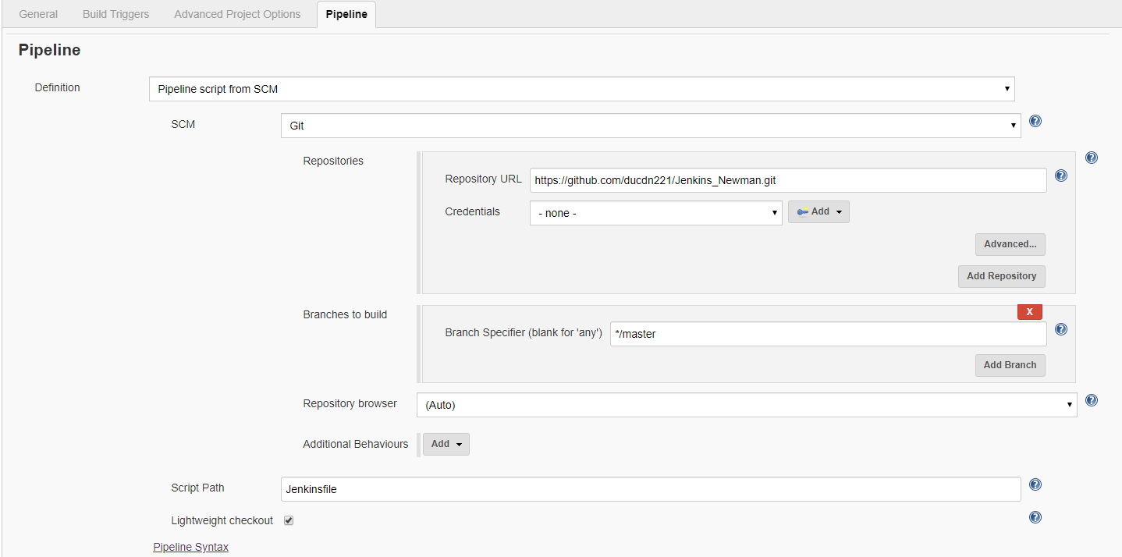
4. HOW TO RUN POSTMAN API TEST COLLECTIon IN JENKINS.
4.5 Intergrate with Jenkins
Step 9: Copy the github repository URL from Github account into Repository URL

Slide 31
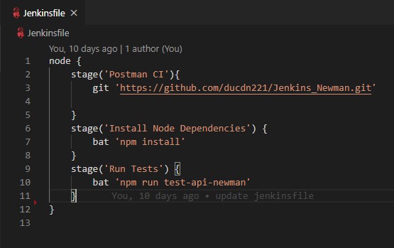
4. HOW TO RUN POSTMAN API TEST COLLECTIon IN JENKINS.
4.5 Intergrate with Jenkins
Step 10: Create Jenkins file on backend

Slide 32
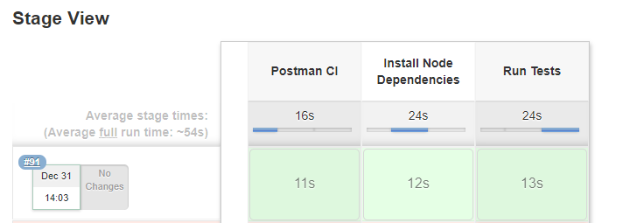
4. HOW TO RUN POSTMAN API TEST COLLECTIon IN JENKINS.
4.5 Intergrate with Jenkins
Step 11: Click Build Now on Jenkins. Result will show like image below

Slide 33
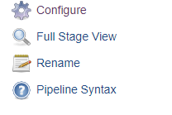
4. HOW TO RUN POSTMAN API TEST COLLECTIon IN JENKINS.
4.5 Intergrate with Jenkins
Step 12: Publish Jenkins HTML Reports for Newman
- Select Pipeline Syntax

Slide 34
4. HOW TO RUN POSTMAN API TEST COLLECTIon IN JENKINS.
4.5 Intergrate with Jenkins
Step 12: Publish Jenkins HTML Reports for Newman
Select ‘publishHTML: Publish HTML reports’

Slide 35
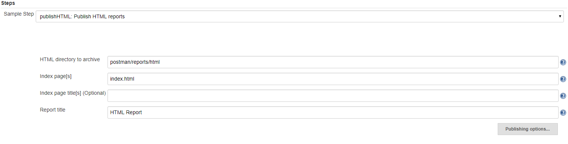
4. HOW TO RUN POSTMAN API TEST COLLECTIon IN JENKINS.
4.5 Intergrate with Jenkins
Step 12: Publish Jenkins HTML Reports for Newman
Fill exact folder contain html file

Slide 36
4. HOW TO RUN POSTMAN API TEST COLLECTIon IN JENKINS.
4.5 Intergrate with Jenkins
Step 12: Publish Jenkins HTML Reports for Newman
Click ‘Generate Pipeline Script’ button and it shows snippet from that input

Slide 37
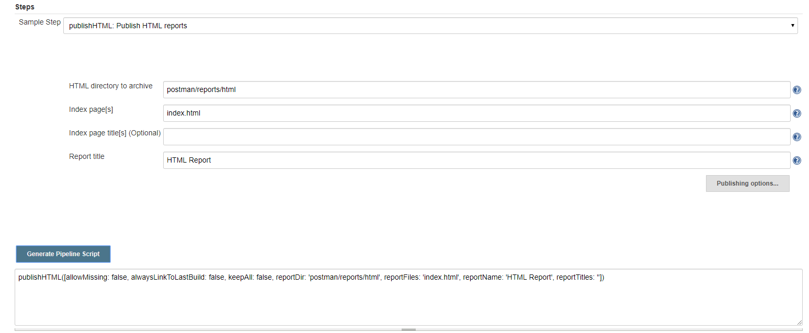
4. HOW TO RUN POSTMAN API TEST COLLECTIon IN JENKINS.
4.5 Intergrate with Jenkins
Step 12: Publish Jenkins HTML Reports for Newman

Slide 38
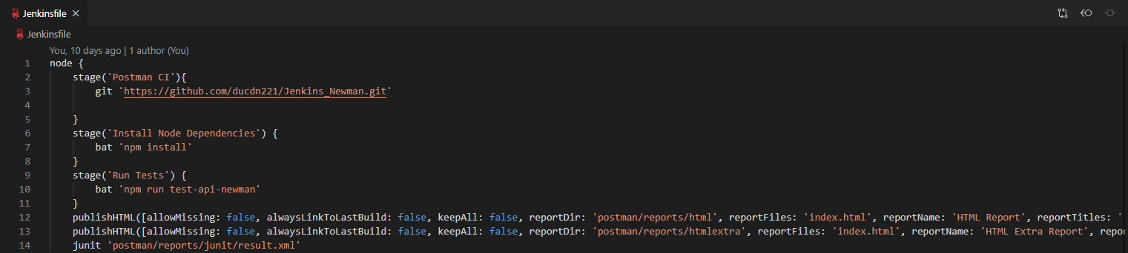
4. HOW TO RUN POSTMAN API TEST COLLECTIon IN JENKINS.
4.5 Intergrate with Jenkins
Step 12: Publish Jenkins HTML Reports for Newman
- Copy snippet into Jenkins file

Slide 39
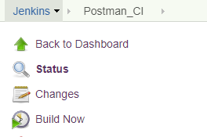
4. HOW TO RUN POSTMAN API TEST COLLECTIon IN JENKINS.
4.5 Intergrate with Jenkins
Step 13: Click build now

Slide 40
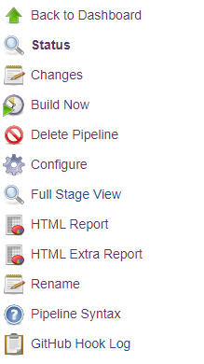
4. HOW TO RUN POSTMAN API TEST COLLECTIon IN JENKINS.
4.5 Intergrate with Jenkins
Step 14: Menu left will show item ‘HTML Report’

Slide 41
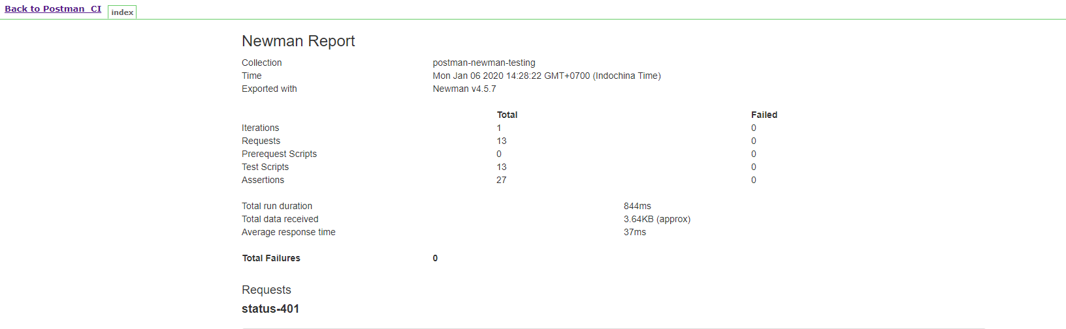
4. HOW TO RUN POSTMAN API TEST COLLECTIon IN JENKINS.
4.5 Intergrate with Jenkins
Step 15: Click Item ‘HTML Report’

Slide 42
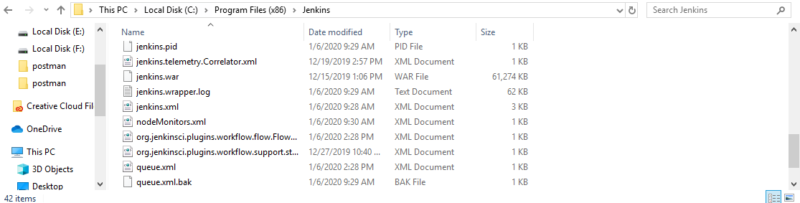
4. HOW TO RUN POSTMAN API TEST COLLECTIon IN JENKINS.
4.5 Intergrate with Jenkins
Step 16: Fix report missing css
- Open folder contain jenkins.xml

Slide 43
4. HOW TO RUN POSTMAN API TEST COLLECTIon IN JENKINS.
4.5 Intergrate with Jenkins
Step 16: Fix report missing css
Open jenkins.xml and add arguments tag:
- Restart service and build again

Slide 44
5. Referrences
- Using Postman's CLI tool for API testing: newman https://dev.to/scampiuk/using-postman-s-cli-tool-for-api-testing-newman-5fn1
- Config Webhook
https://dzone.com/articles/adding-a-github-webhook-in-your-jenkins-pipeline
- Publish Jenkins HTML Reports for Newman
https://www.toolsqa.com/postman/publish-jenkins-html-reports-for-newman/

Slide 45
5. Referrences
Fix missing css when report viewed in Jenkins
https://kb.froglogic.com/squish/integrations/jenkins/content-security-policy-csp-web-report/

